Slide 1


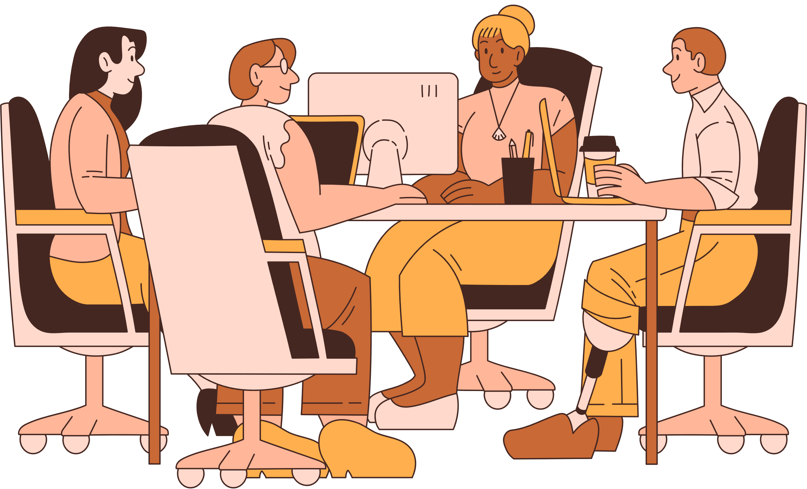

WORKEASE EMPLOYEE SERVICE HUB
Presentation by Team 4

Slide 2

WHAT WE WILL TALK ABOUT
Overview
Our Team
Problem Statement
Solution & Workflow
Features
Future Scope
Discussion Board

Slide 3








HELLO, EVERYONE!
MEET OUR TEAM
Divya
Yaswanth
Tejaswi
Pranali
Chaitanya
Srihitha

Slide 4
WORKEASE EMPLOYEE SERVICE HUB
Self-service platform built using ServiceNow that enables employees to easily access workplace services such as creche booking, parking, leave planning, and cabin booking.
The portal streamlines requests, automates approvals, and enhances employee experience through a centralized and user-friendly system.

Slide 5
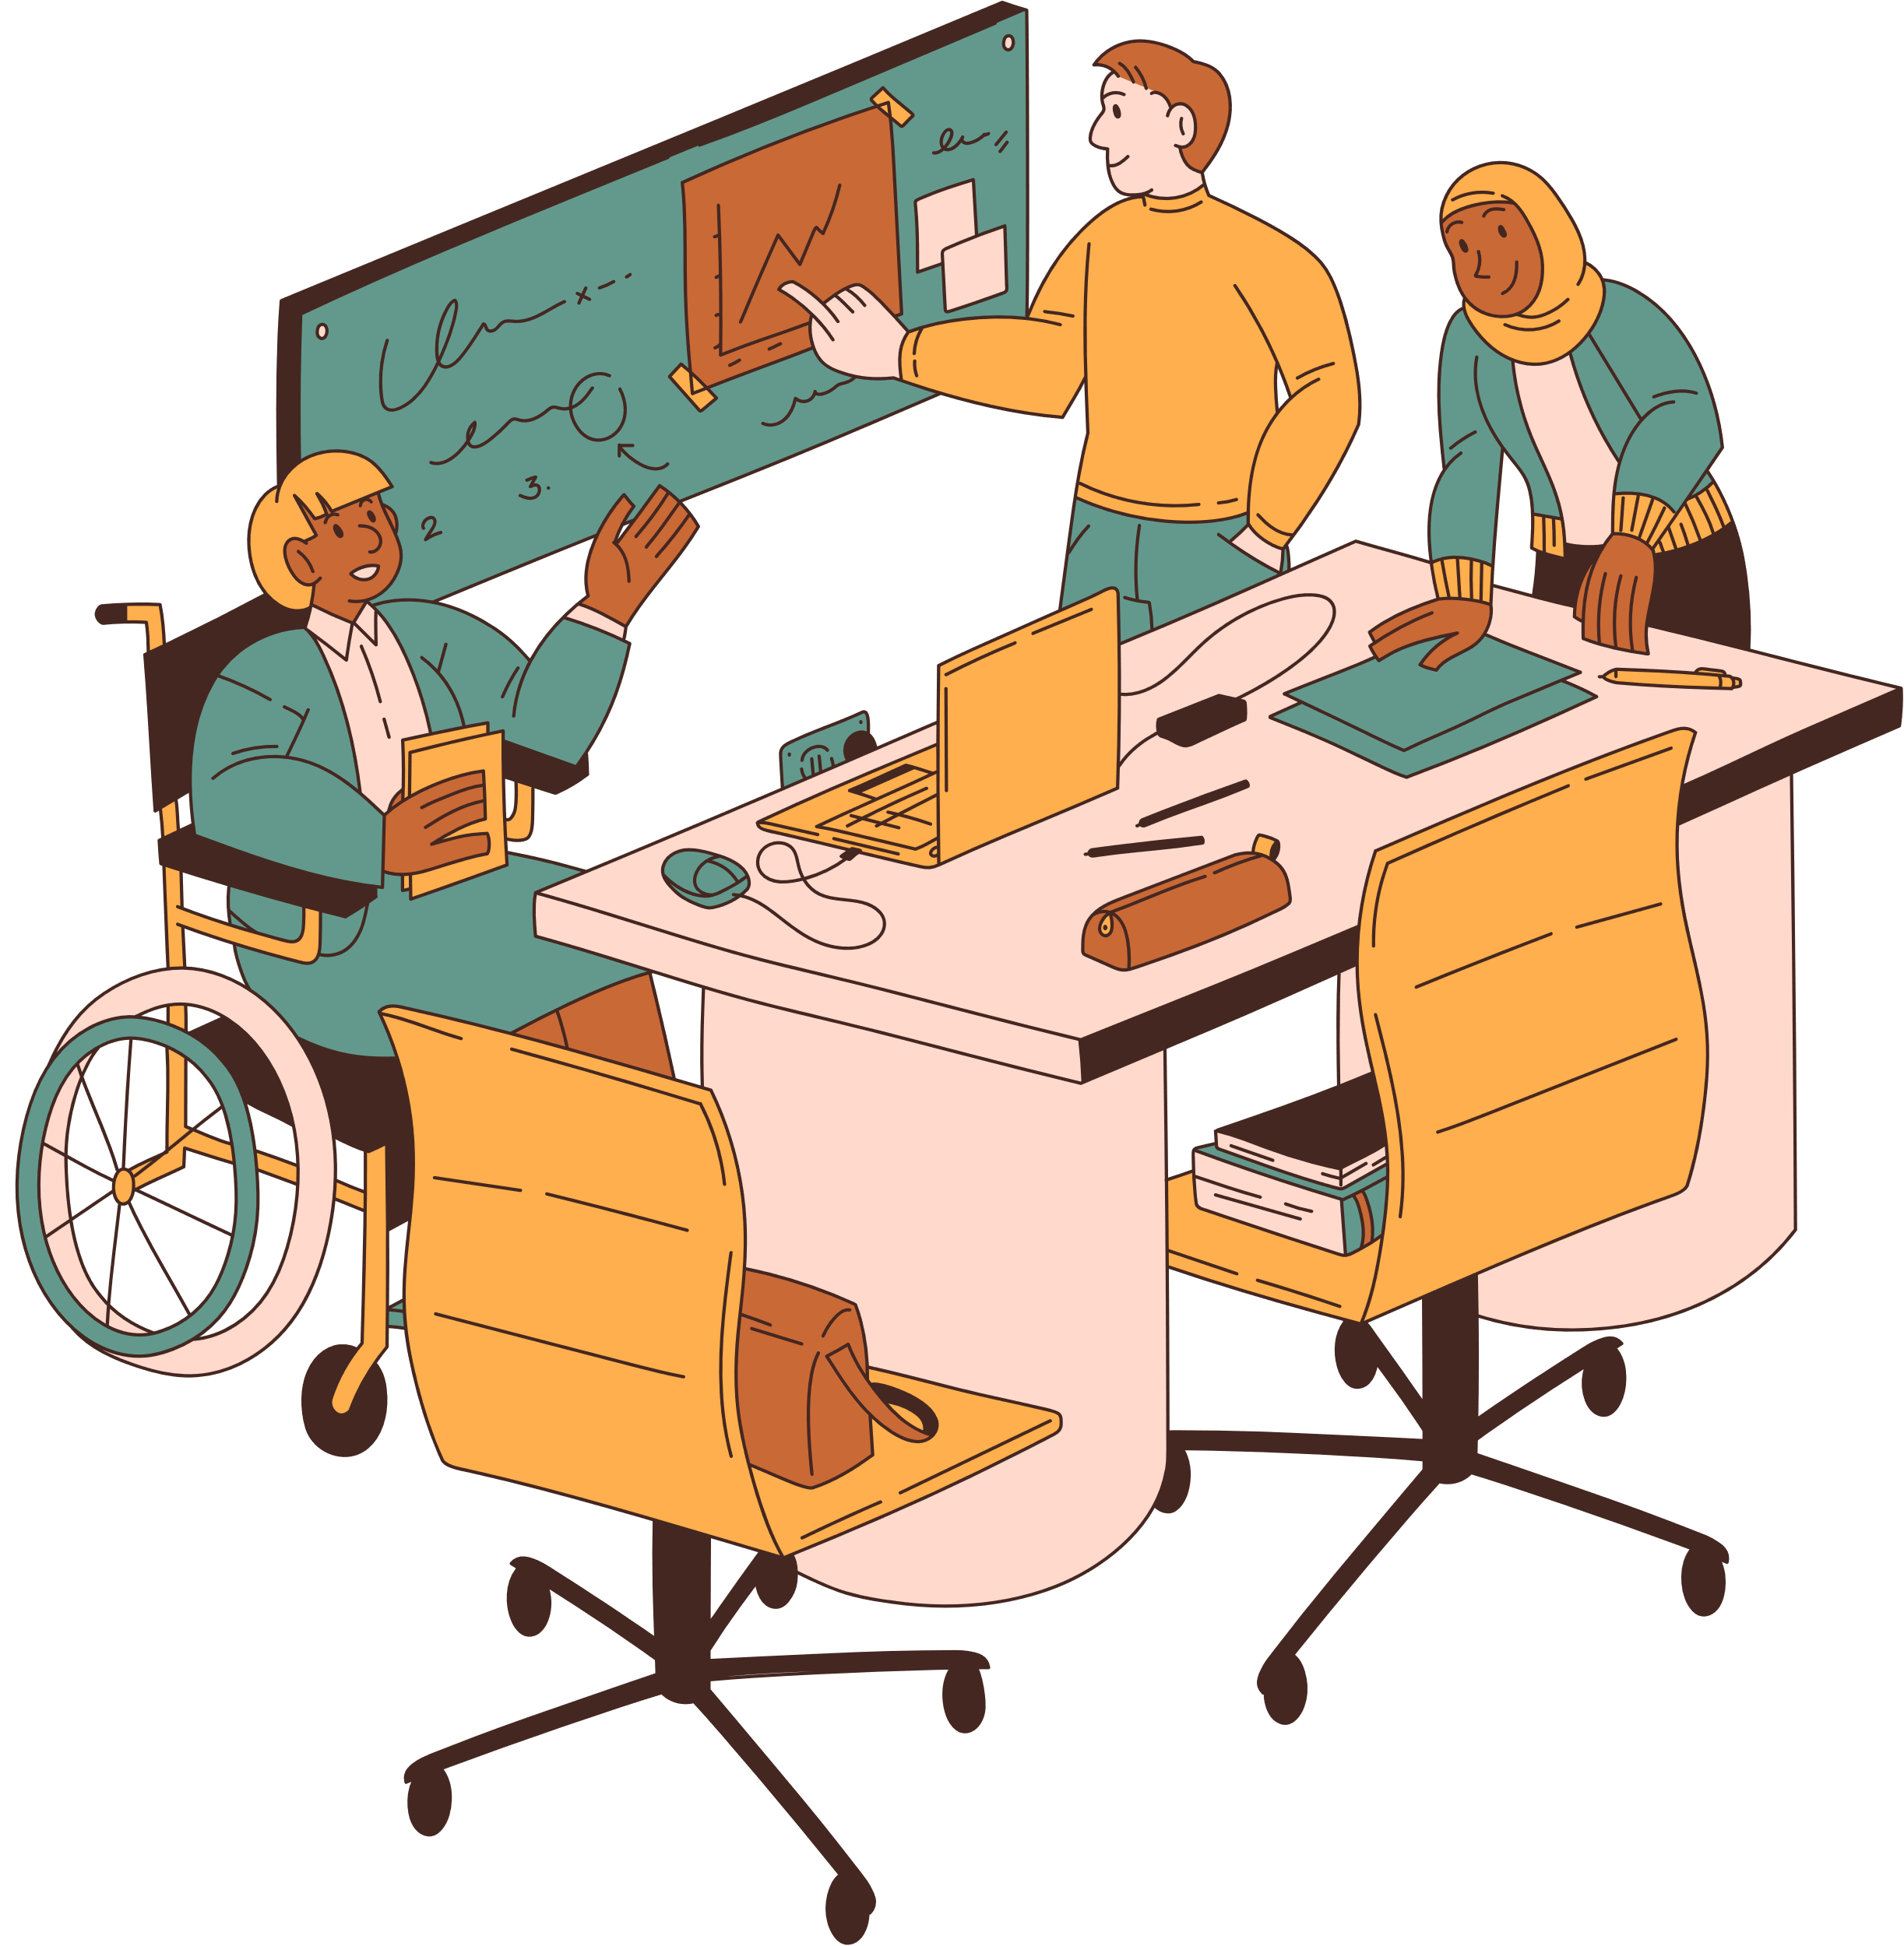
PROBLEM STATEMENT
To eliminate manual processes and reduce dependency on emails, calls, and offline coordination.
Lack of visibility into availability
Time-consuming manual follow-ups
Errors in booking or scheduling
Inefficient utilization of company resources

Slide 6
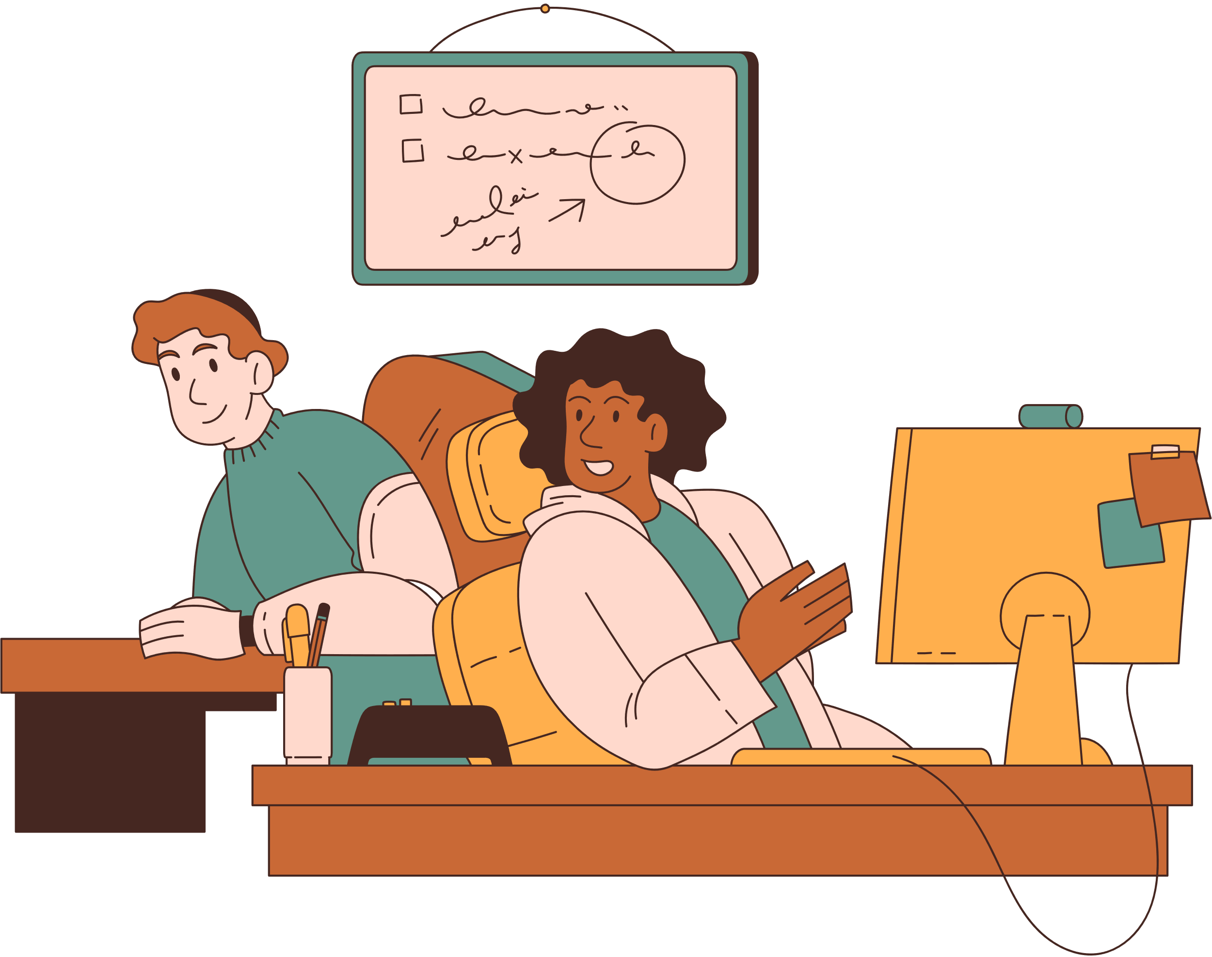
PROPOSED SOLUTION
Centralizes multiple workplace services into a single, user-friendly ServiceNow portal.
Automating workflows, improving booking accuracy, and providing real-time availability.
The system significantly enhances employee productivity and satisfaction.

Slide 7
FEATURES
Parking Management
Cabins and Conferences
Creche Booking
New to City
Leave Management
Feedback & Suggestions
HTTPS://IND-NOV-5453-0004.LAB.SERVICE-NOW.COM/WORKEASE_HUB

Slide 8

FUTURE SCOPE
Third-party payment gateway integrations
Mobile application development outside ServiceNow's native app
Improving services in IT Infrastructure (cafeteria ,Lounge booking)

Slide 9

QUESTIONS ??

Slide 10





Thank
You!

